Slide 1

A NOVEL METHOD FOR HANDWRITTEN DIGIT RECOGNITION SYSTEM
Team ID: PNT2022TMID28606
NILAVANI K(TL)
YAMINI D
SNEHASRI SV
VASUNTHRA R
(Agni College Of Technology)

Slide 2
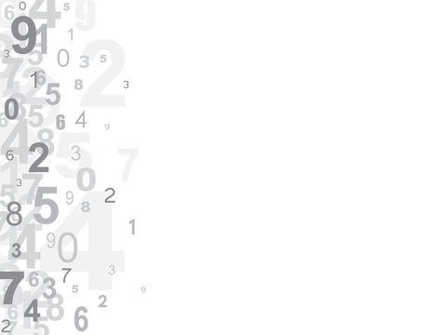
INTRODUCTION
Character recognition plays an important role in the modern world. It can solve more complex problems and makes humans’ job easier.
An example is handwritten character recognition.
This is a system widely used in the world to recognize zip code or postal code for mail sorting.
There are different techniques that can be used to recognize handwritten characters. They are Pattern Recognition and Artificial Neural Network (ANN).
Handwritten Digit recognition uses Neural Network to recognize them.

Slide 3
What are Neural networks?
* The neural network architecture refers to the elements that are connected to make a network that is used for handwriting recognition.
* The human brain works loosely to inspire neural networks. It is based on the idea of how neurons pass signals around the human brain to process input into an output.
* Several units are layers to form a network and arrange from the ones that are responsible for receiving input to the layer that is responsible for output values.
* Different neural network architectures can be used to provide different results from the input images of handwriting. It is because architectures are based on different parameters, data, and duration of training.

Slide 4
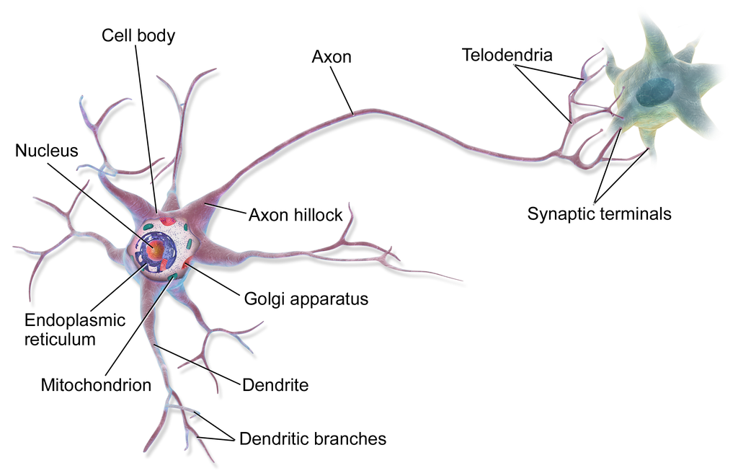
A NEURAL CELL IN BRAIN

Slide 5
Convolutional Neural Network Architecture
* It consists of three main parts, two convolutional blocks and one fully connected neural network layer.
* The inputs to this model are 28x28 images.
First Convolutional Block:
* A 28x28 image is taken as input to this block. A padding of 2 units is added to the image so as to retain its dimensions after a convolution operation on the image by 16 5x5 filters/kernels.
* The output of the convolution gives 16x28x28 volume, which is then input to a ReLU activation function followed by a Maxpool operation. ReLU activation is used to introduce some non-linearity.
* This block outputs a 16x14x14 volume.

Slide 6
Second Convolutional Block:
First step is again a convolution operation on 16x14x14 by 32 5x5kernels with padding of 2 units, obtaining a 32x14x14 volume.
It is passed through a ReLU activation followed by a Maxpool operation.
Second convolutional block outputs a 32x7x7 volume.
Fully connected Neural Layer:
Here, a single hidden layer of 10 nodes is taken as the fully connected layer.
Finally, the output of the fully connected layer is passed to a softmax function to obtain the output result of recognition.

Slide 7
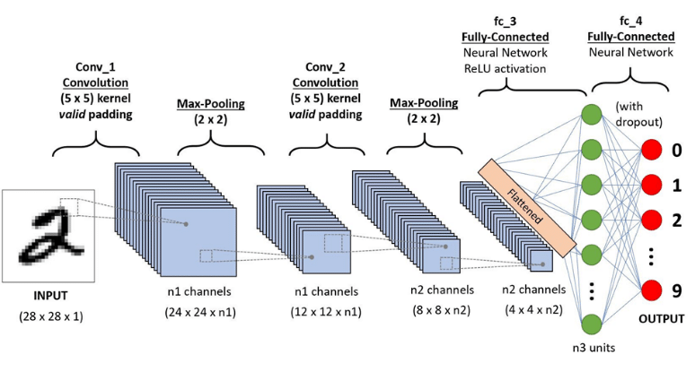
Architecture of a Convolutional Neural Network

Slide 8
Why Convolutions?
* Convolution is a simple mathematical operation between two matrices in which one is multiplied to the other element wise and sum of all these multiplications is calculated.
* Convolutions are performed for various reasons-Convolutions provide better feature extraction.
* They save a lot of computation compared to ANNs.
Less number of parameters are created than those in pure fully connected layers.
* Due to less number of required parameters , lesser fully connected layers are needed.

Slide 9
Training Dataset
The dataset has sample Handwriting digits for evaluating machine learning models on the problem of Handwriting digit recognition.
It contains 21,000 testing and 21,000 training of Handwriting digits from (0 to 9).
Each of the digits is standardized and cantered in a grayscale (0 – 255) images with a size of 28x28 pixel. In each of the images consists of 784 pixels that represent the structures of the digits.

Slide 10
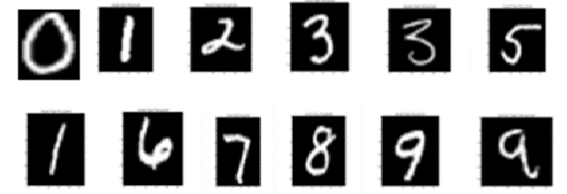
The digit images pixels are used as features vector and decision tree as classifiers.
Moreover, data repository is used for training and testing the datasets so, the result shows that the decision tree classifier is effective in recognition of Handwriting digits

Slide 11
Pre-Processing of images
Pre-processing of images is done using a python library called Open cv.
Preprocessing is the second phase of OCR after the digital image.
The digitized image is pre-processed to remove noise, and then it is checked for skewing.
Preprocessing is essential for developing data that that are easy for optical character recognition systems.
The main objective of pre-processing is to remove the background noise, enhance the region of interest in the image, and make a clear difference between foreground and background.

Slide 12
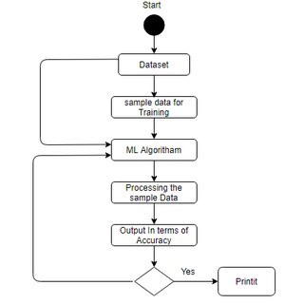
Sequence Diagram

Slide 13
Segmentation
Segmentation of the image is done by the concept contours in Opencv
Contours
Contours can be explained as simply curve joining all the continuous points, having same color or intensity
The contours are a useful tool for shape analysis and object detection and recognition.

Slide 14
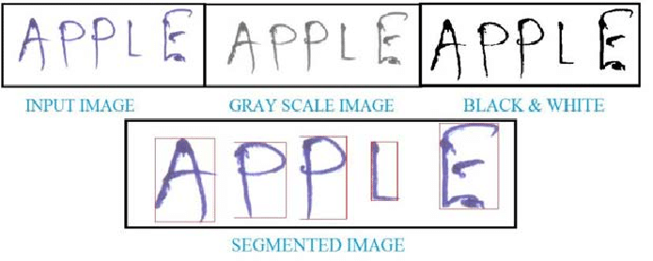
EXAMPLE OF SEGMENTED IMAGE

Slide 15
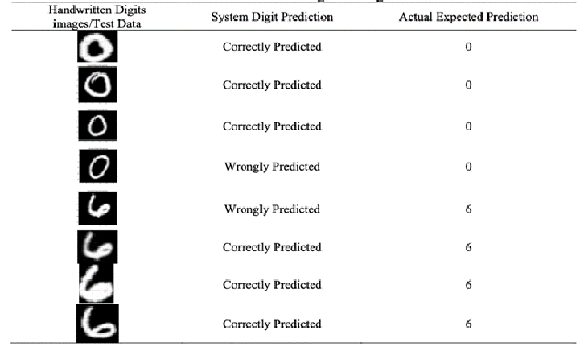

Slide 16
MAIN GOAL & APPLICATIONS
Handwritten Digit Recognition is used to recognize the Digits which are written by hand.
A handwritten digit recognition system is used to visualize artificial neural networks.
It is already widely used in the automatic processing of bank cheques, postal addresses, in mobile phones etc.

Slide 17
Conclusion
The handwritten digit recognition using convolutional neural network has proved to be a fairly good efficiency.
It works better than any other algorithm, including artificial neural networks.

